Slide 1

Week 12 Presentation
Wednesday, November 20, 2019
Notes:
Welcome to our week 12 presentation. We are ATLAS Data Mining team. [self intro based on the list, name, major, title] The objective of this project is to study what impacts students’ matriculation from a financial perspectives.

Slide 2



The SMMC Data Mining Team -
Smruthi Iyengar
Kagen Quiballo
Hanqing Wang
Yuxin Wang
Notes:
The objective of this project is to study what impacts students’ matriculation from a financial perspectives.

Slide 3
Presentation Overview
1. Reinvestigate financial aid distribution by college
External vs. Institutional
2. Types of charge VS. hold
Notes:
Does funding method (methods of payment/financial aid) impact enrollment in a subsequent term？
Are students from a specific college or degree program more or less likely to receive a financial aid？
explore relationship between type of charges (late fee charge) and hold

Slide 4
Are students from a specific college more/less likely to receive financial aid? (19,454 undergrads 1718 yr)
INSTITUTIONAL
EXTERNAL
BENEFITS
EXEMPTIONS
WAIVERS
SCHOLARSHIPS
PRIZE/AWARD
UIC GRANT
SCHOLARSHIP (has ‘External’ in desc.)
GRANT
LOAN
WORK
5,611
14,640

Slide 5
EXTERNAL (scholarship, grant, loan, work)
COLLEGE | STUDENTS IN COLLEGE | HOW MANY RECEIVED AID | PERCENTAGE RECEIVED AID | AVG AMOUNT ($)
LAS | 9,691 | 7,618 | 78.61% | 13,375
Engineering | 3,604 | 2,430 | 67.43% | 14,743
Business | 2,987 | 2,207 | 73.89% | 13,455
Arch/Design/Art | 1,064 | 792 | 74.44% | 14,762
App. Health Sci | 999 | 765 | 76.58% | 13,235
Nursing | 477 | 318 | 66.67% | 17,438
Education | 388 | 328 | 84.54% | 12,549
Urb Planning | 147 | 104 | 70.75% | 15,148
Public Health | 97 | 78 | 80.41% | 14,445
ALL COLLEGES | 19,454 | 14,640 | 75.25% | 14,350
KEY FINDINGS
Inverse relationship between percentage and avg amount
Reason: more money to give to less people?

Slide 6
INSTITUTIONAL (scholarship, grant, waiver, award)
COLLEGE | STUDENTS IN COLLEGE | HOW MANY RECEIVED AID | PERCENTAGE RECEIVED AID | AVG AMOUNT ($)
LAS | 9,691 | 2,707 | 27.93% | 4,632
Engineering | 3,604 | 1,034 | 28.69% | 4,772
Business | 2,987 | 1,054 | 35.29% | 4,824
Arch/Design/Art | 1,064 | 277 | 26.03% | 4,868
App. Health Sci | 999 | 276 | 27.63% | 4,696
Nursing | 477 | 75 | 15.72% | 4,456
Education | 388 | 95 | 24.48% | 4,075
Urb Planning | 147 | 31 | 21.09% | 4,322
Public Health | 97 | 62 | 63.92% | 5,910
ALL COLLEGES | 19,454 | 5,611 | 28.84% | 4,728
KEY FINDINGS
Approximately same avg amount except for Public Health
Nursing lowest % for both types
Public Health highest % for both types
Reason: more money to give to less people?

Slide 7
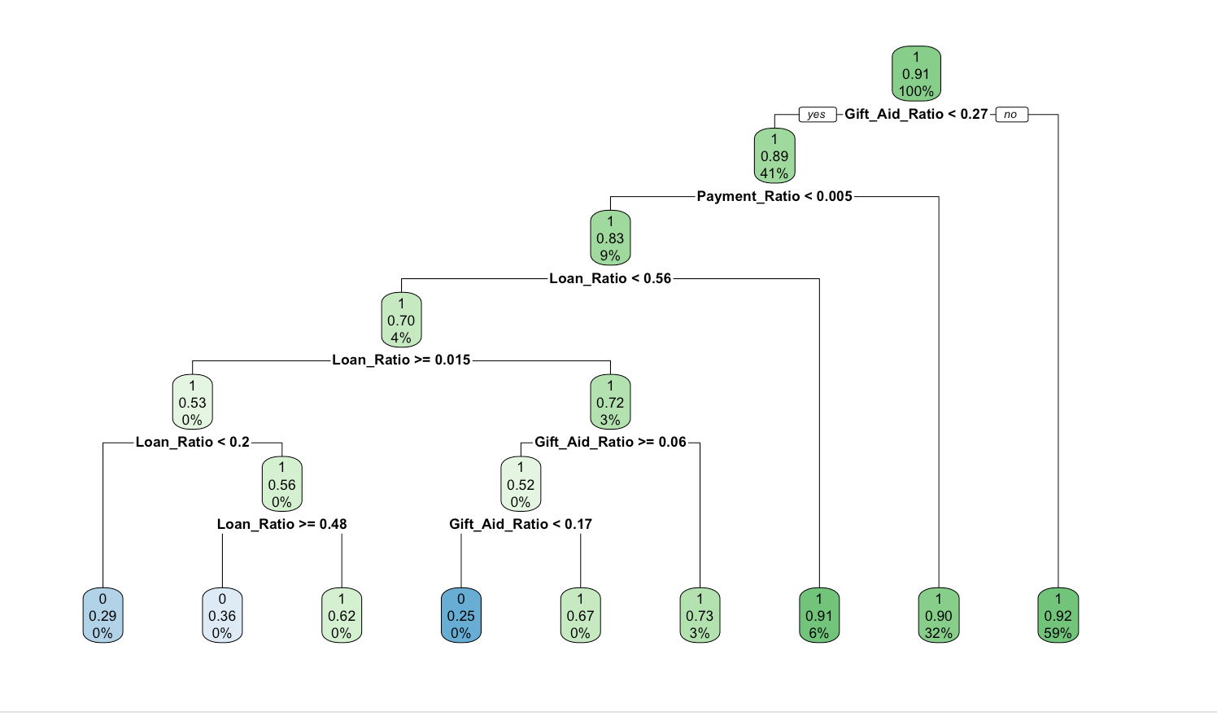
Predicting Matriculation Rate Based on Ratios
“Trained” Model with 75 % of data set (N = 14,584)
1 means continued. 0 did not continue
Overall 91% of population continued
Most Likely to drop:
Payment ratio less than .0005
Loan ratio less than .48
Gift Aid Ratio .06 to .17

Slide 8
Accuracy Rate of Model
Tested Model Using 25% of the original data set
Overall Accuracy Rate= 90.86%
True Positive = 90.97% = Great
True Negative = 25.00% = Not Good,better off guessing
N = 4,862 | Predicted No | Predicted Yes
Actual No | 2 | 6
Actual Yes | 438 | 4416

Slide 9
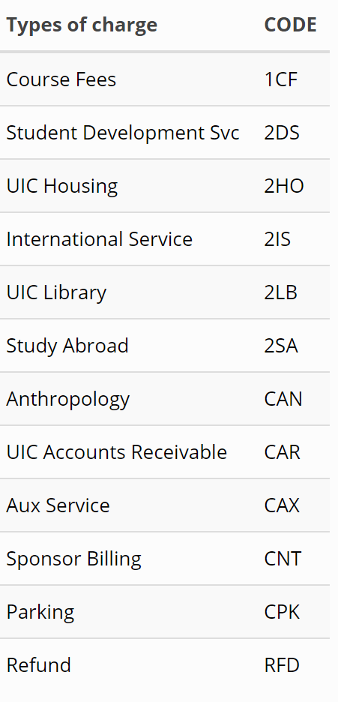
Types of charge VS. hold
One model predicting hold based on previous semester charge incurred
None, Some
One model predicting which type of hold based on previous semester charge incurred
None, 9H, 9R, Both

Slide 10
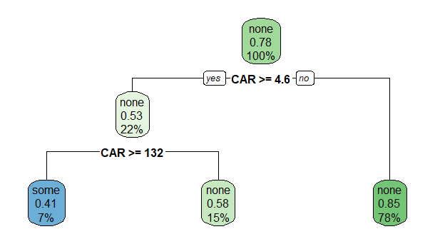
Types of charge VS. hold -- model #1
Among 12 types of charge, late fee charge (CAR) is significant for predicting hold
When total late fee charge incurred exceeds 132 in fall 2017, the student has 41% chance ends up with at least 1 hold in Spring 2018

Slide 11
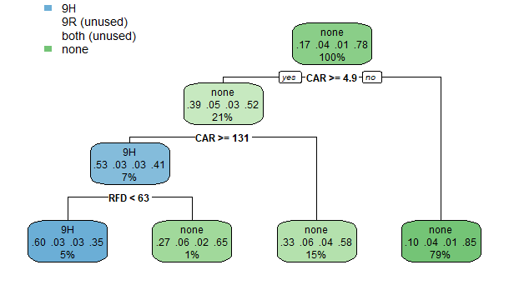
Types of charge VS. hold -- model #2
late fee charge (CAR) and Refund(RFD) are significant for predicting hold
When total late fee charge incurred exceeds 131 and refund is less than 63 in fall 2017, the student has 60% chance ends up with 9H hold in Spring 2018

Slide 12
Conclusion
External financial aid tends to have an inverse relationship between percentage (of students that receive aid) and average amount of aid received
Institutional financial aid to have a more even distribution for average amount of aid received (Public Health is the exception)
Late fee charge and Refund are significant for predicting hold
Notes:
Are students from a specific college or degree program more or less likely to receive a financial aid？
explore relationship between type of charges (late fee charge) and hold

Slide 13

THANK YOU FOR LISTENING
QUESTIONS?

